Slide 1


Slide 2


Rationalize the Consumption of Antibiotics

Slide 3
Student Names: Department
Mohamed Said Abdel Fattah CS
Ahmed Mohamed Ismail CS
Ali Ahmed Ali IS
Arafa Ahmed Salem IS
Rady Mohamed Rady CS
Alaa Abdullah Tawfik IS
Supervised By:
Dr. Eng. Samy El Mokadem Dr. Abdelrahman El-Akhdar
Eng. Ahmed Rashad
Eng. Rabab Mahmoud

Slide 4
Problem Statement:
Antibiotics are a powerful class of drugs that are used to treat bacterial infections. However, the overuse and misuse of antibiotics can lead to the development of antibiotic-resistant bacteria, which can cause serious and difficult-to-treat infections .Rationalizing the consumption of antibiotics involves promoting appropriate use of antibiotics to reduce the development and spread of antibiotic-resistant bacteria while ensuring that patients receive the necessary treatment for their bacterial infections.

Slide 5
Project Objectives:
Rationalizing the consumption of antibiotics system is an important as it solve
The problem of irrational use of antibiotics as it become a global issue that
threatens public health, and it requires a multi-faceted approach to address it. By
rationalizing the consumption of antibiotics, we can help preserve the effectiveness
of antibiotics for future generations and ensure that patients receive the best possible care for their bacterial infections.
Objectives:
reduce the development and spread of antibiotic-resistant bacteria.
improve patient outcomes.
reduce healthcare costs.
promote public health.
Monitoring and extracting patients' statistics at the hospital .
Monitoring and extracting statistics of antibiotic consumption in the hospital.

Slide 6
Abbreviations
DFD Data Flow Diagram
ERD Entity Relationship Diagram

Slide 7
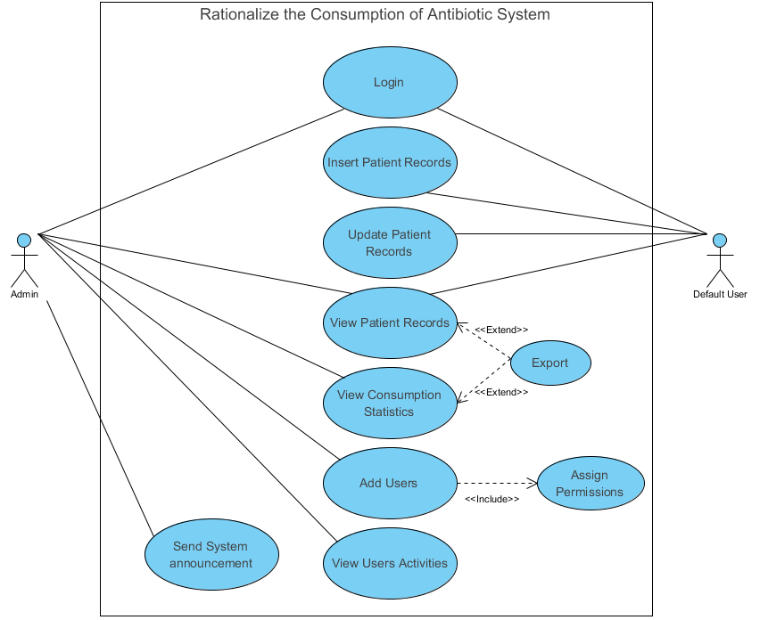
Use case Diagram

Slide 8
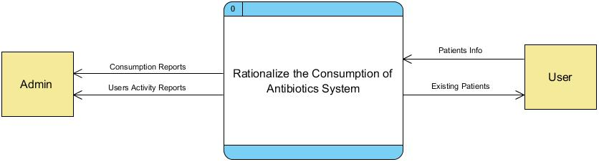
DFD Context
The base level of DFD on RCA Project shows the main input/ output data on general bases, The user is responsible for inserting patients’ data into the system, Whereas the admin can monitor these data and see reports

Slide 9
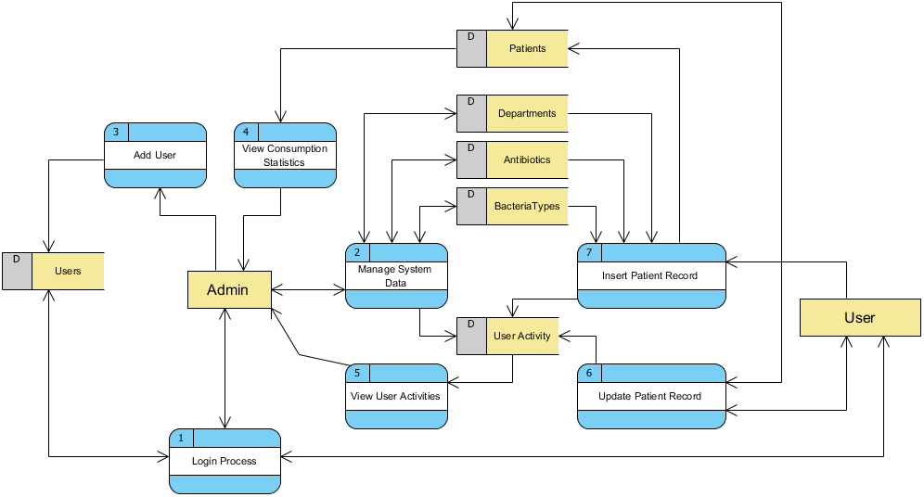
DFD Level 1

Slide 10
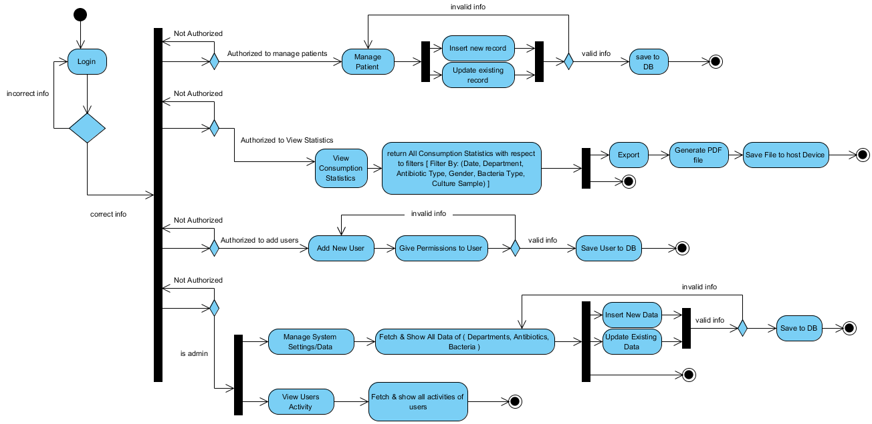
Activity Diagram

Slide 11
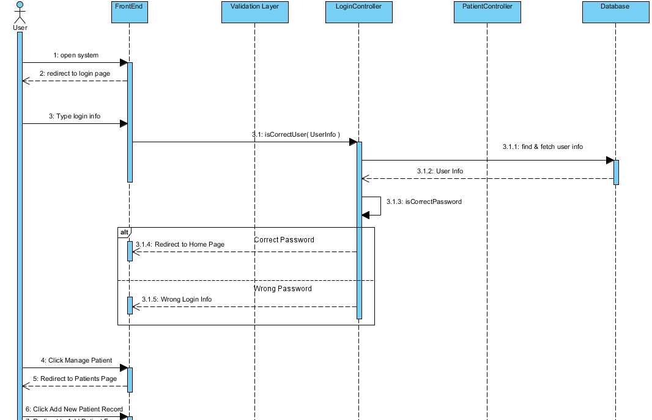
Insert Patient Sequence

Slide 12
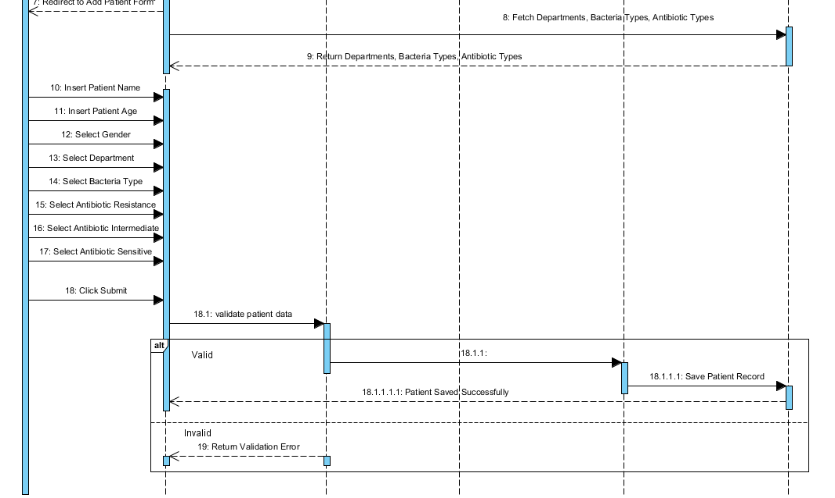
Insert Patient Sequence

Slide 13
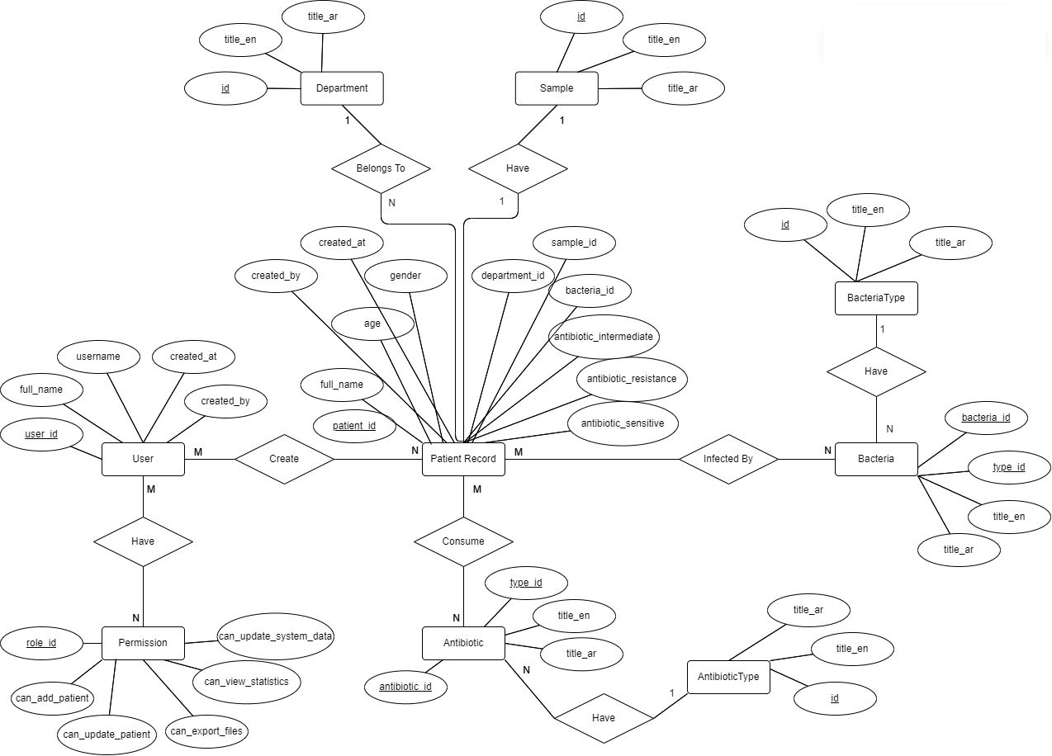
ERD

Slide 14
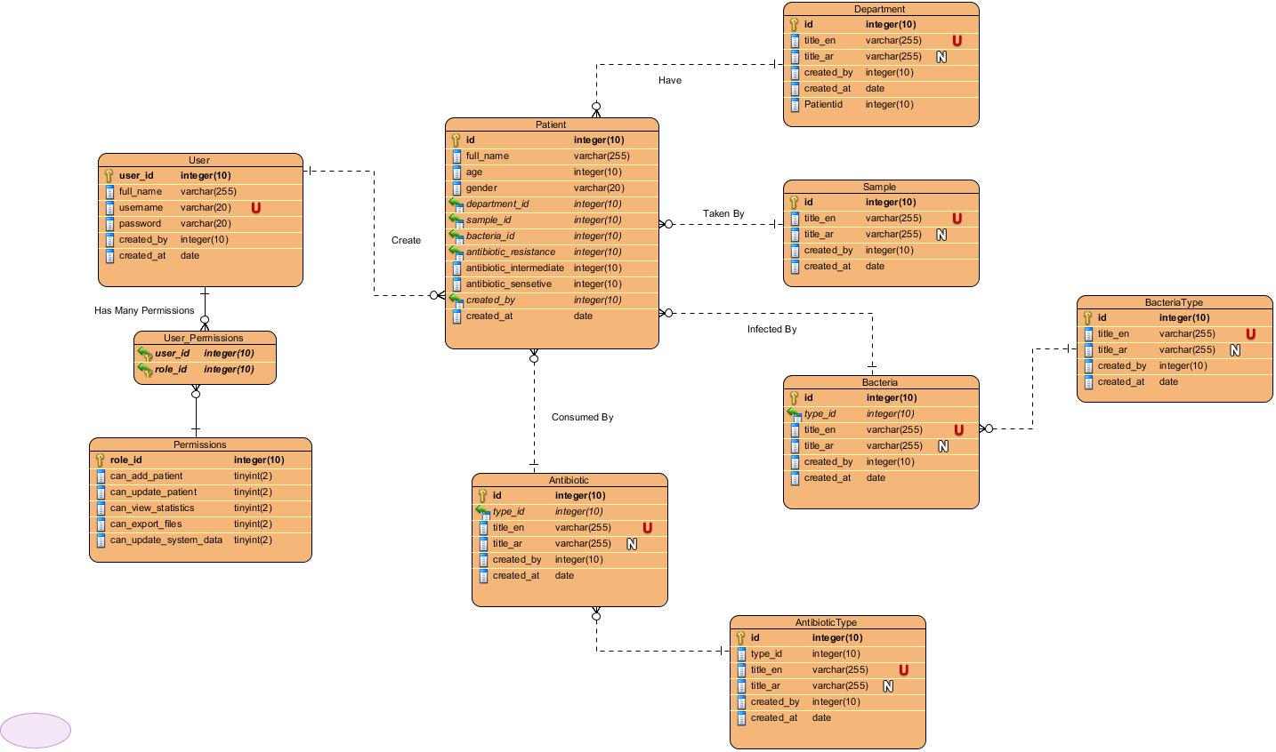
Schema Model

Slide 15
Tools
Front-end :
html5 , css3, JavaScript
jQuery
bootstrap
Back-end :
Laravel – PHP
MySQL
API
Mobile Application
flutter

Slide 16
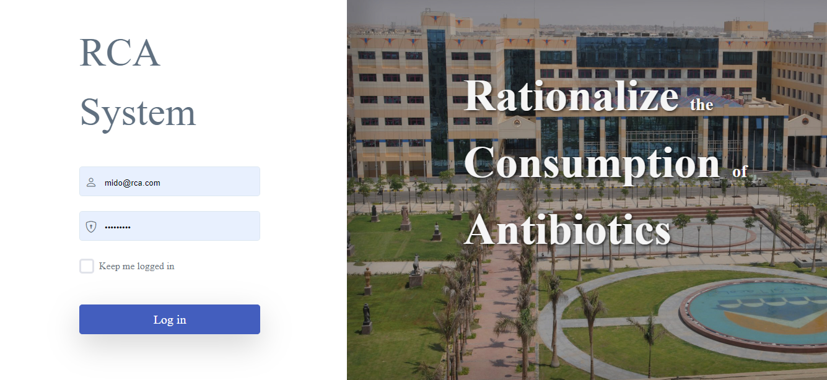
Login Page

Slide 17
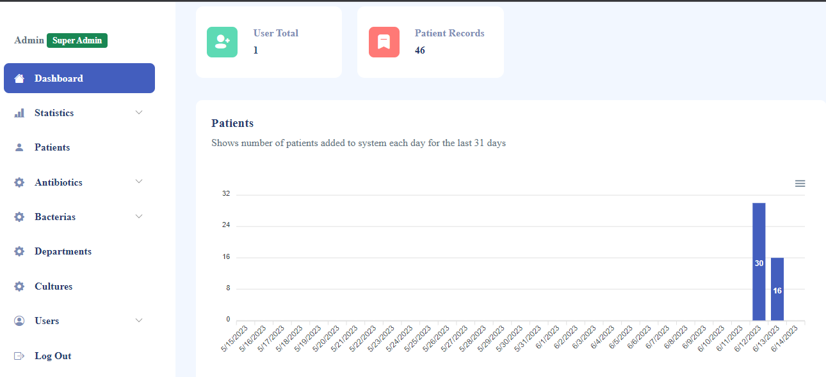
Graph Show Number Of Patients

Slide 18
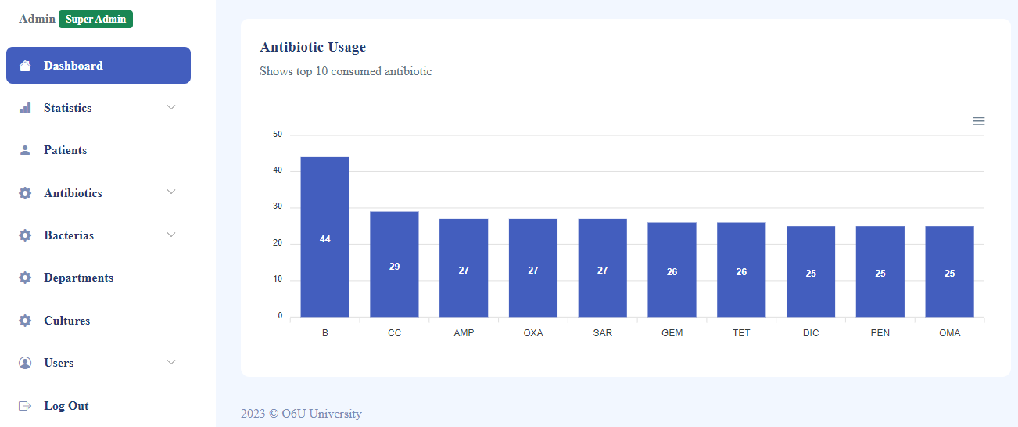
Graph Show Antibiotic Usage

Slide 19
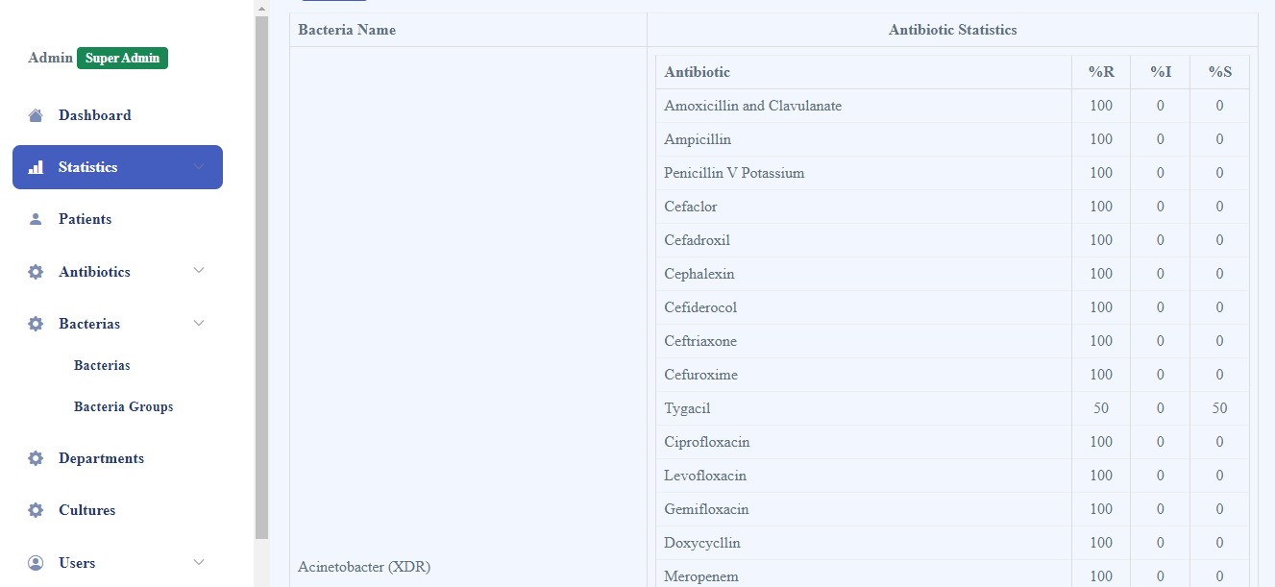
Statistics Page

Slide 20
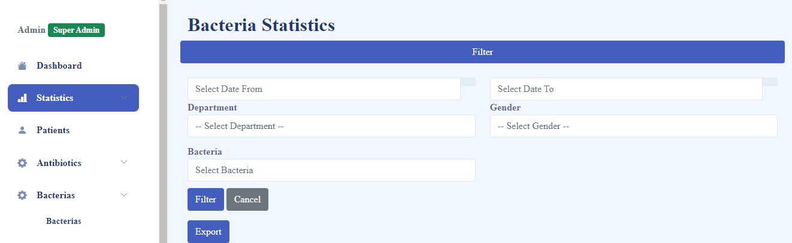
Filter Process

Slide 21
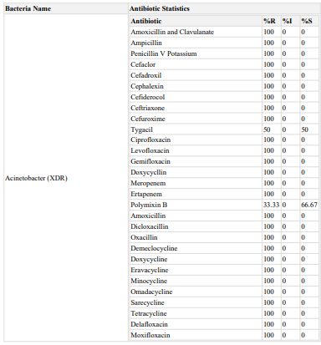
Example Of Statistics

Slide 22
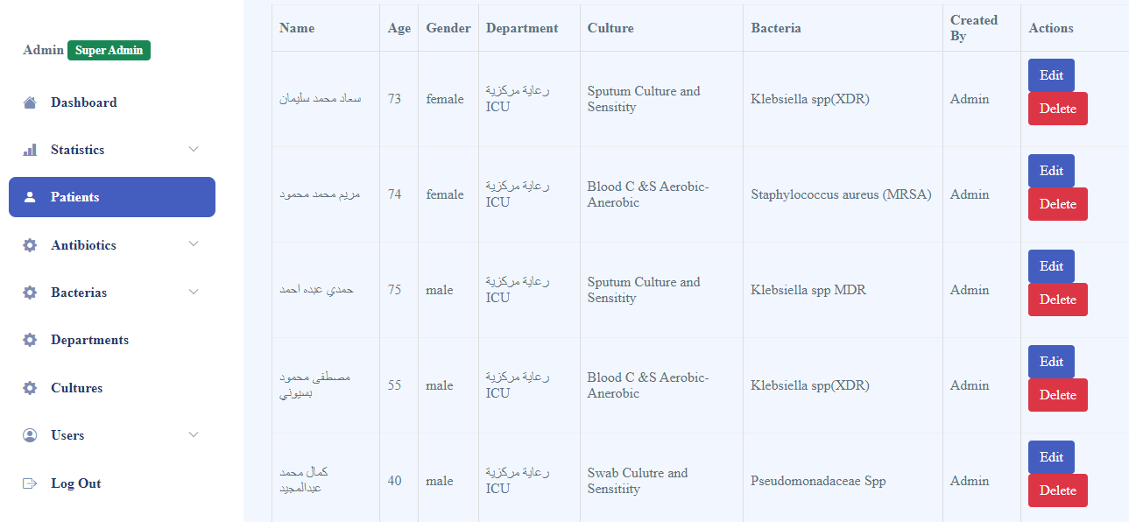
Patient Page

Slide 23
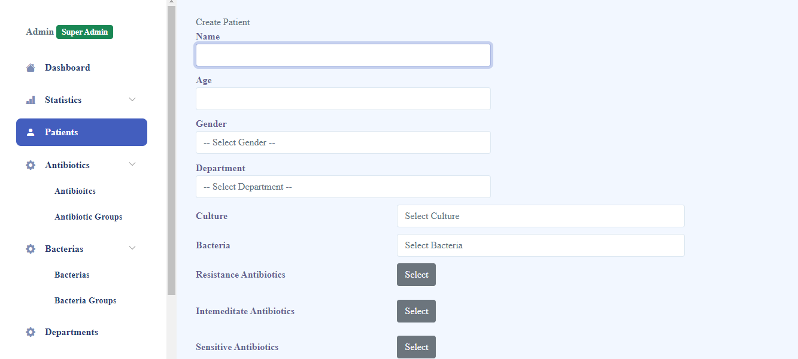
Adding New Patient

Slide 24
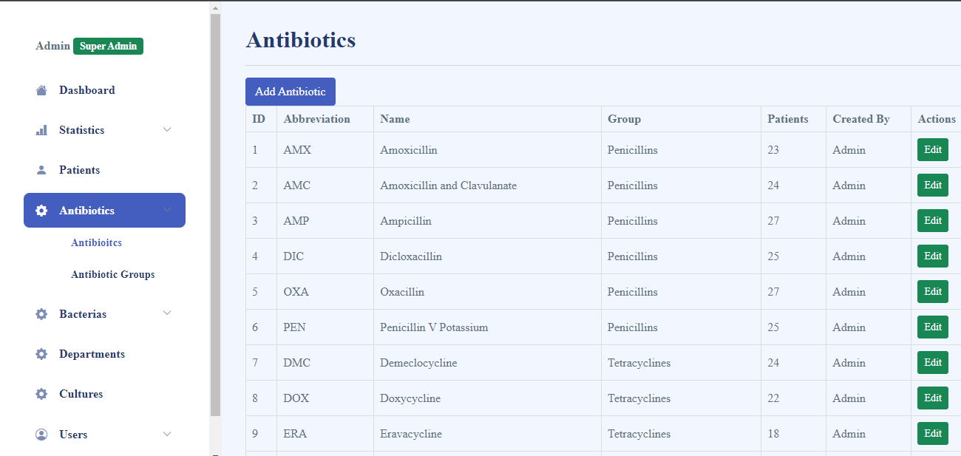
Antibiotics Page

Slide 25
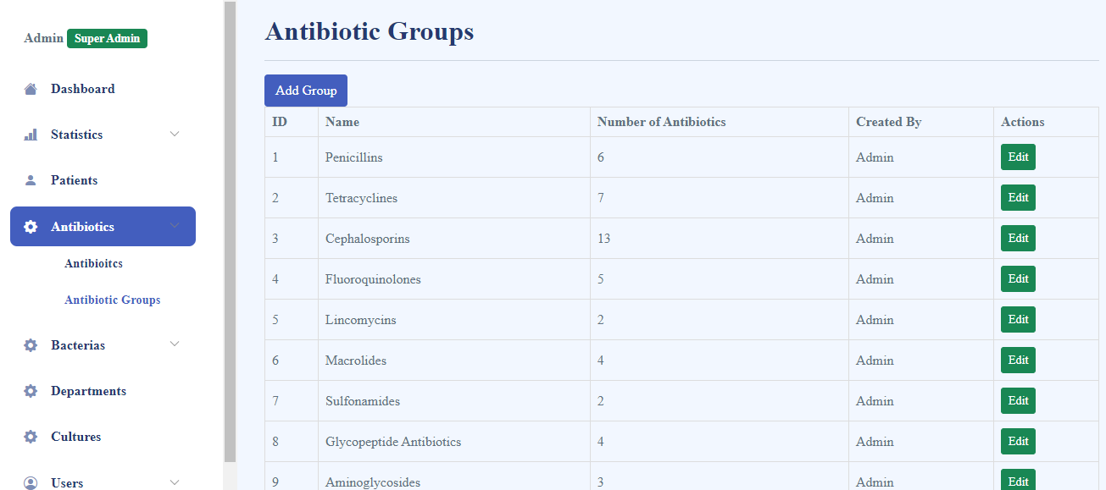
Antibiotic Groups Page

Slide 26
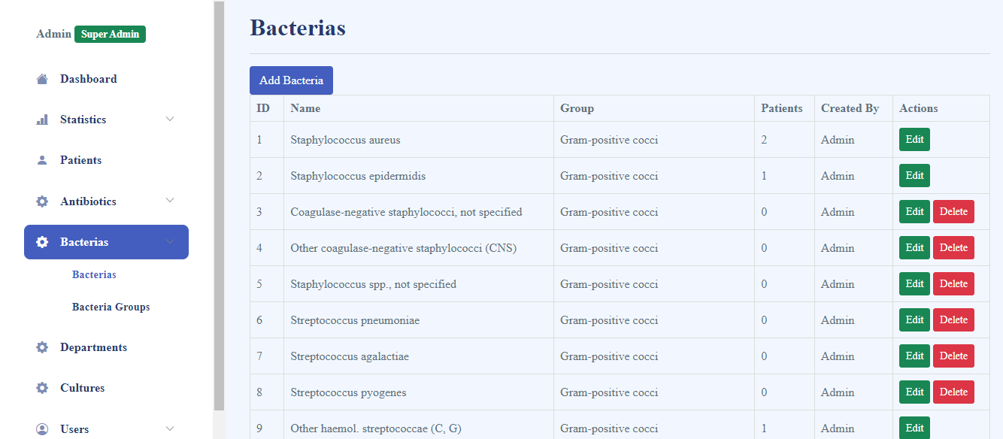
Bacteria Page

Slide 27
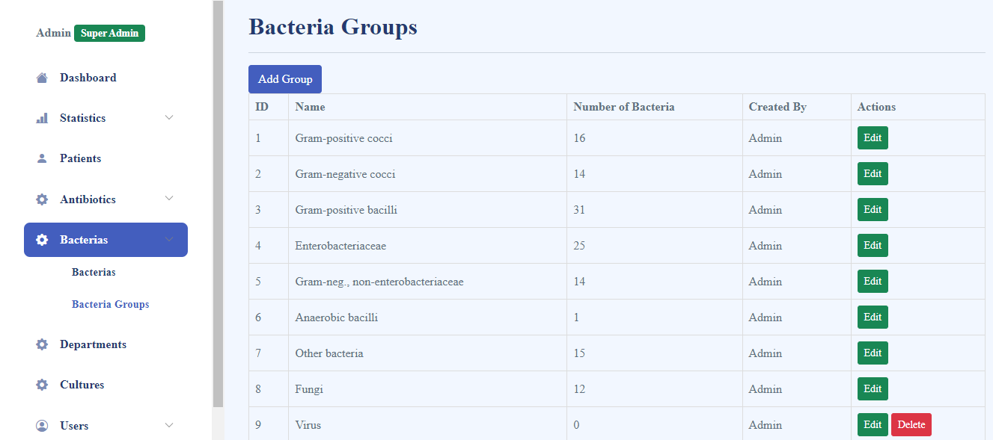
Bacteria Group Page

Slide 28
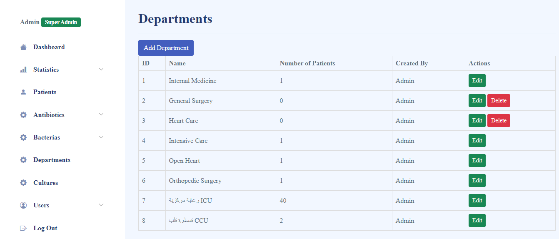
Department Page

Slide 29
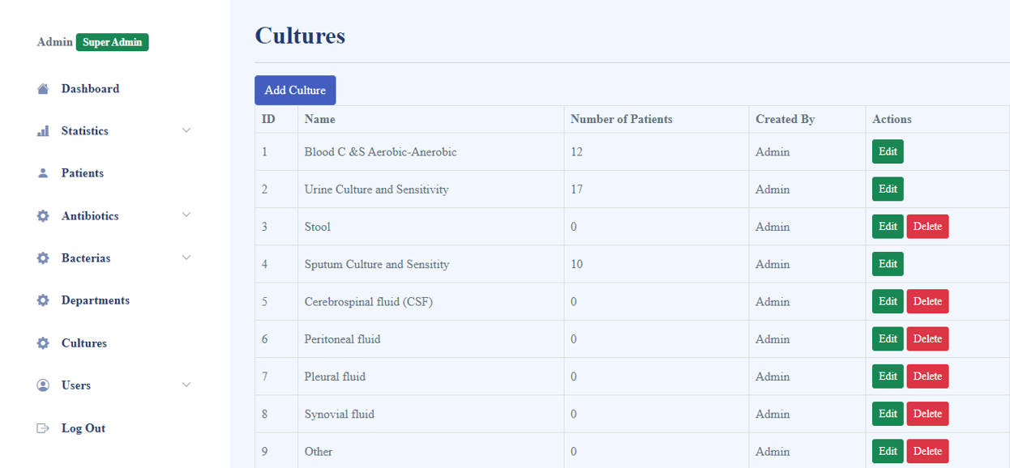
Culture Page

Slide 30
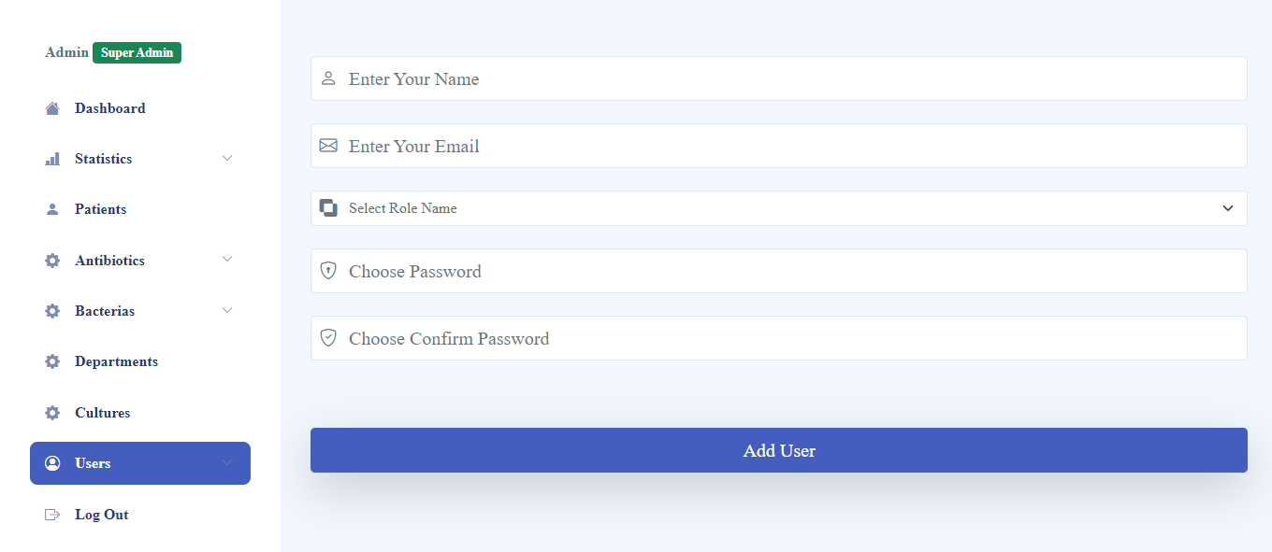
Adding User Page

Slide 31
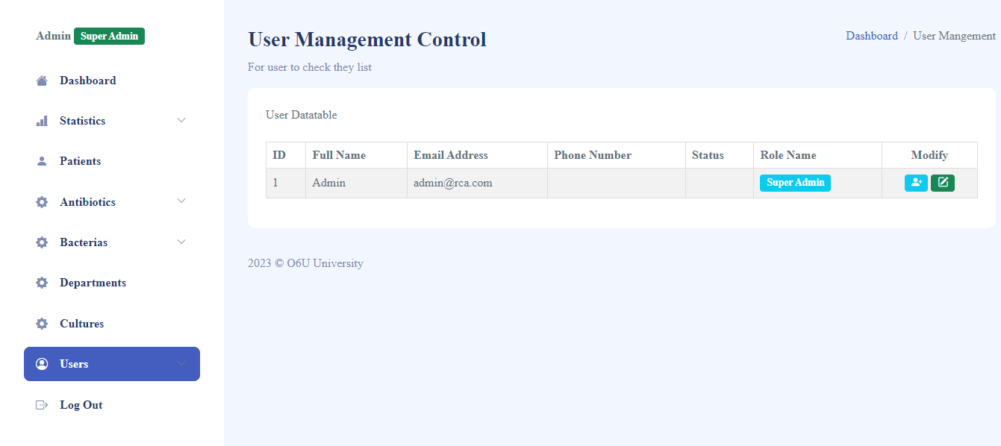
Controlling Users Page

Slide 32
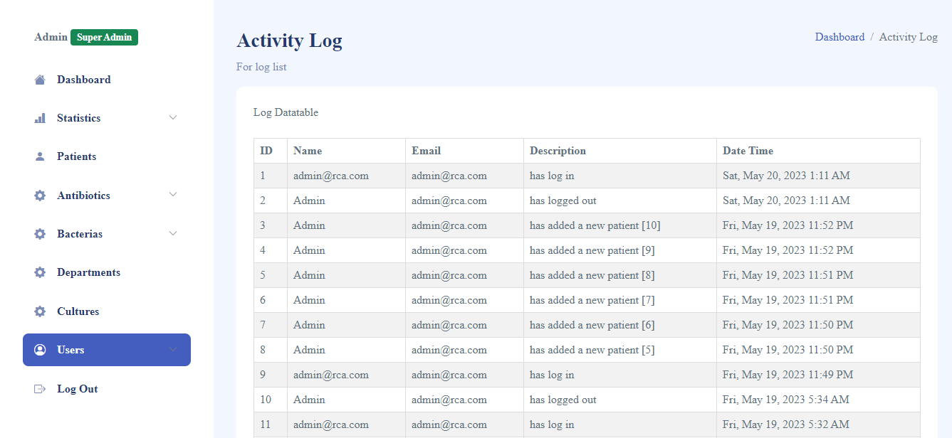
Users Activity Page

Slide 33
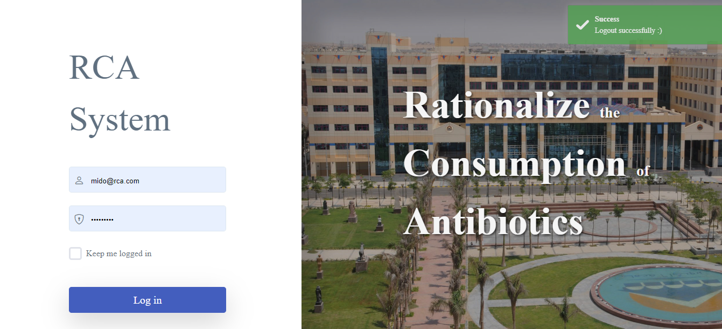
Log Out Page

Slide 34
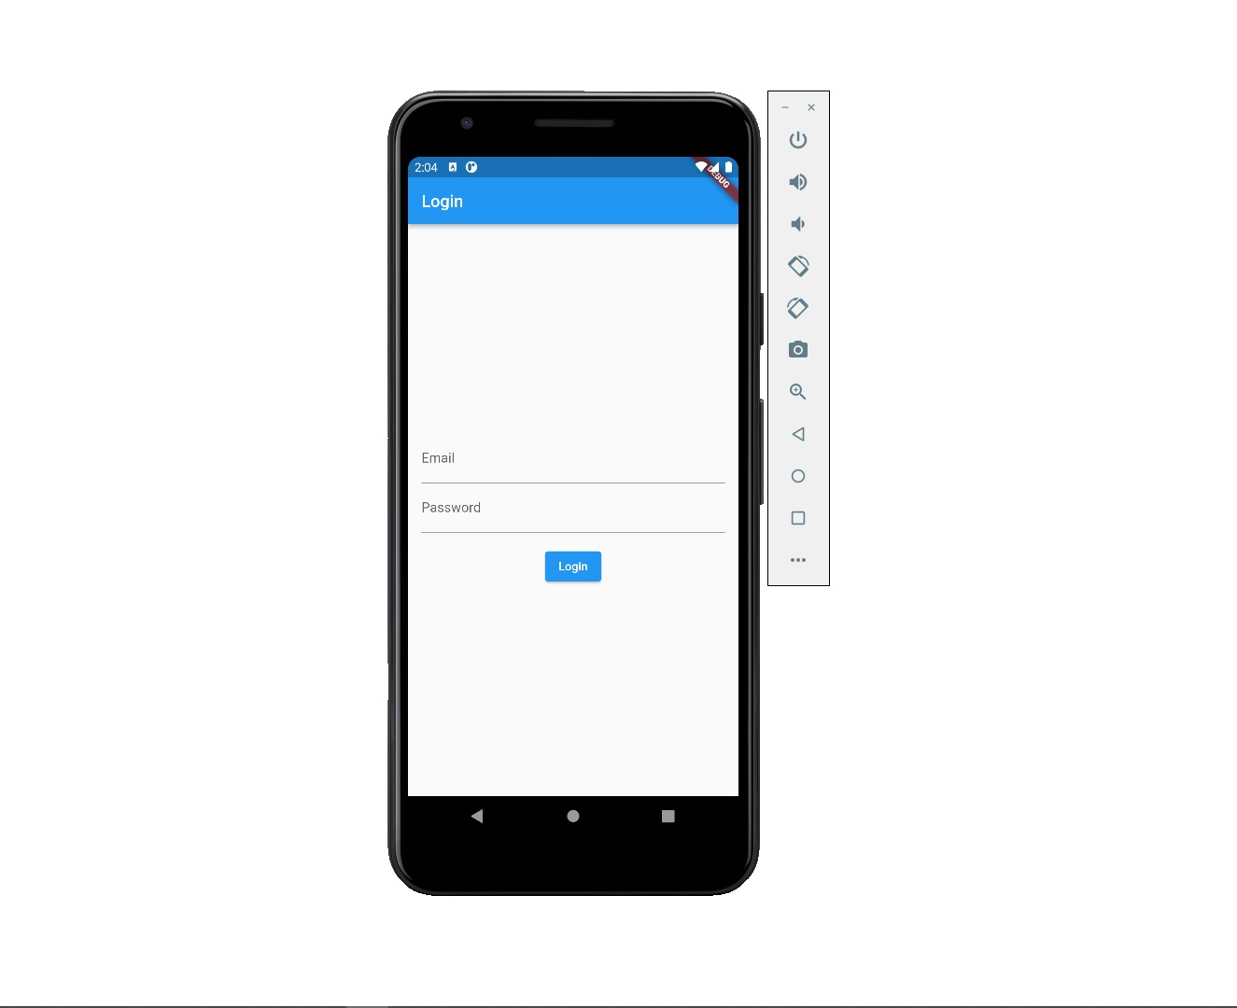
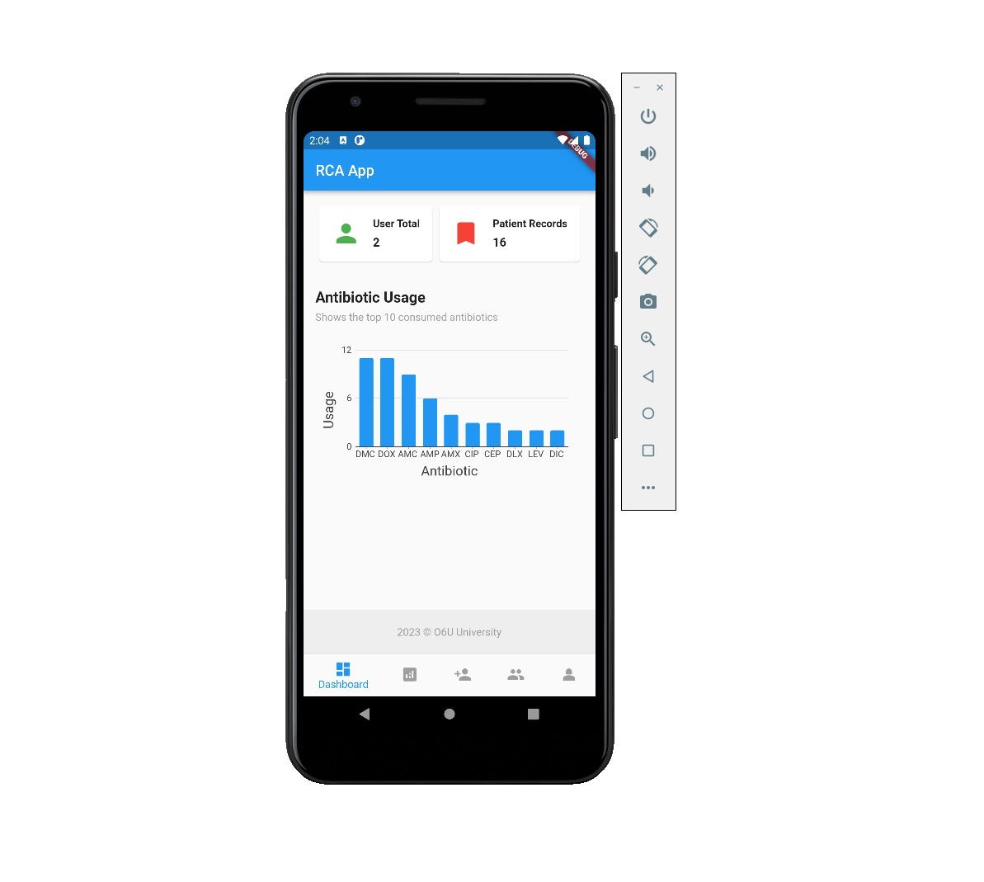
Screen Shoots Of Mobile Application

Slide 35
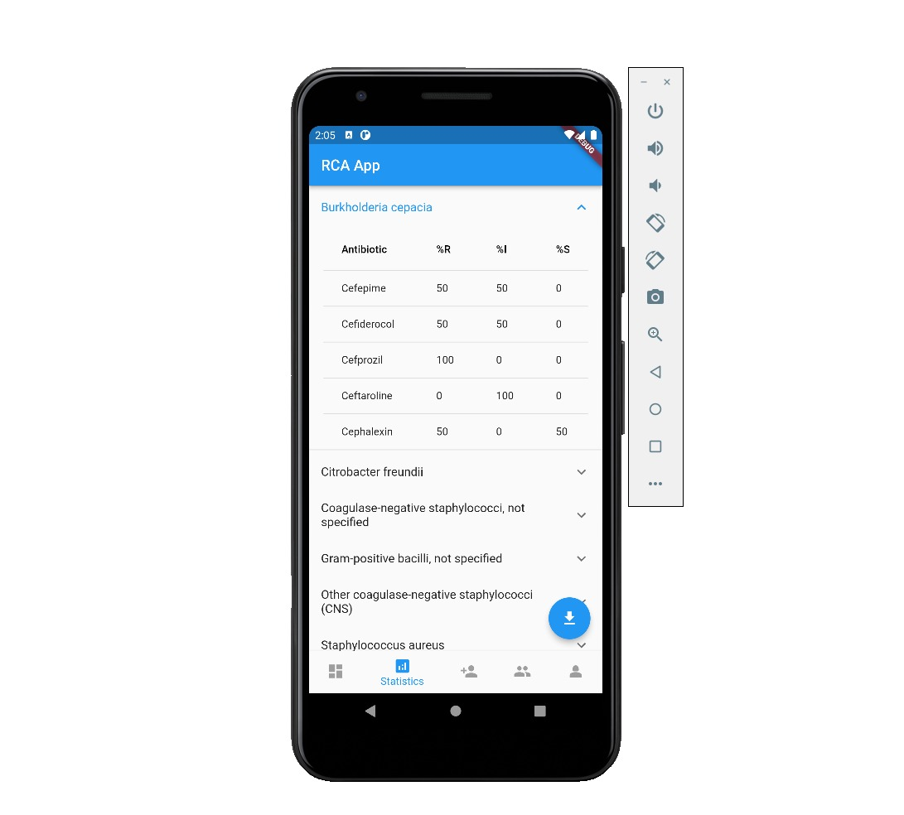
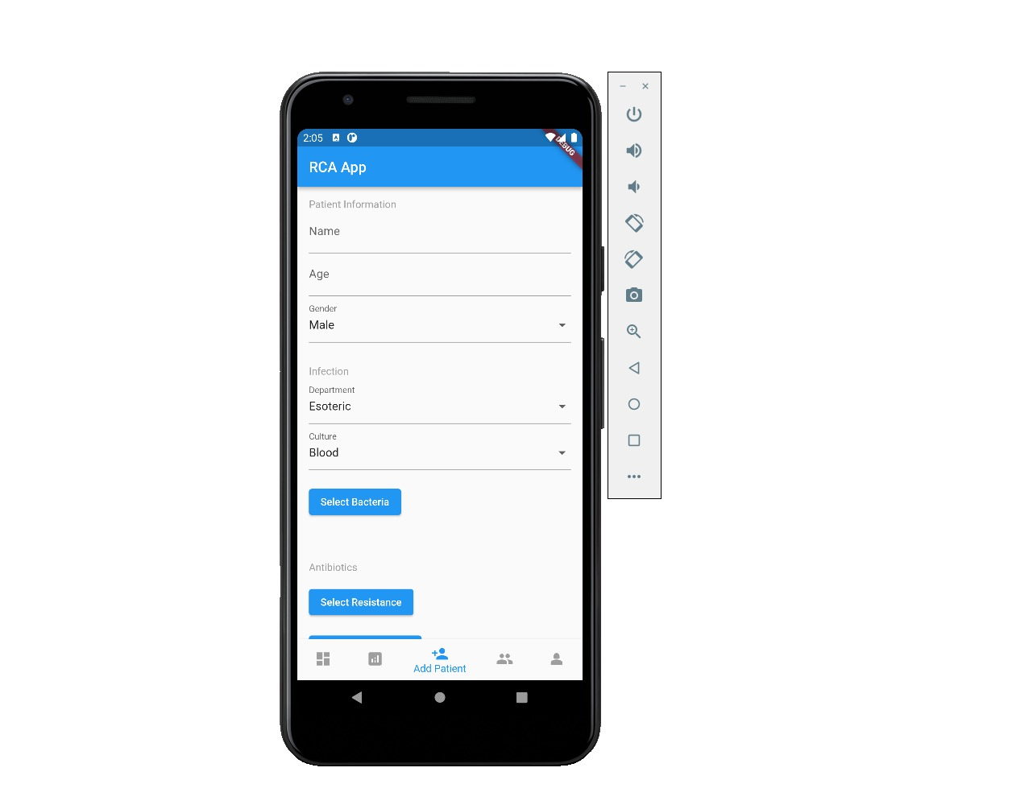
Process Of Adding New Patient & Showing Statistics Page

Slide 36
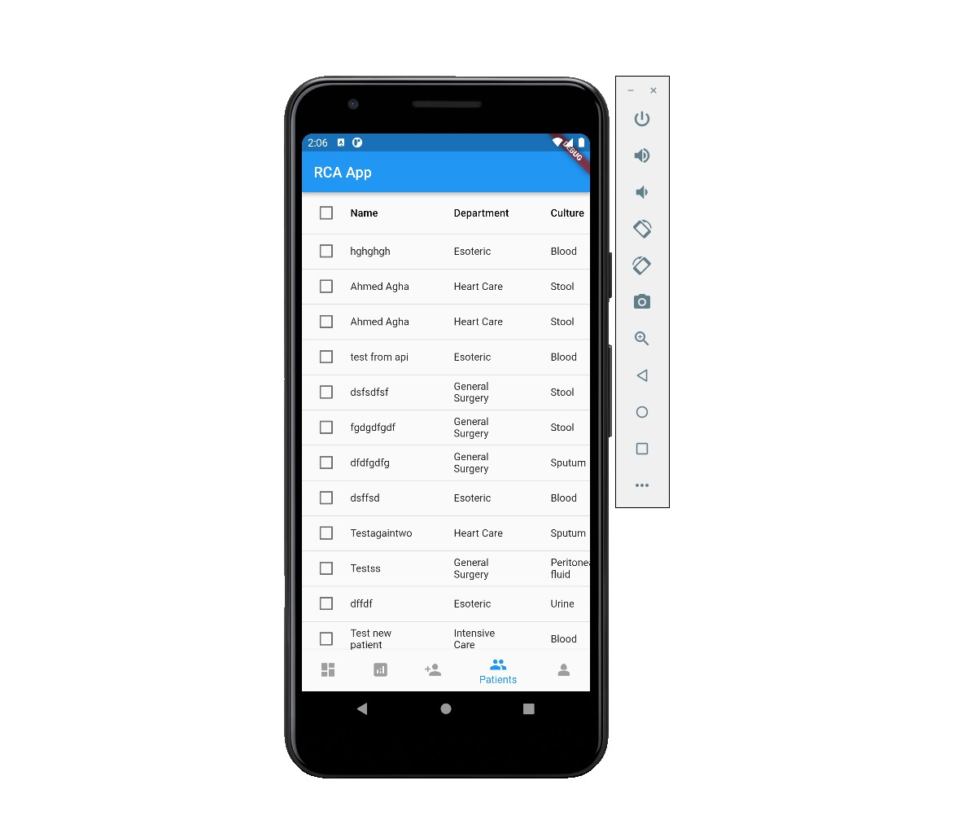
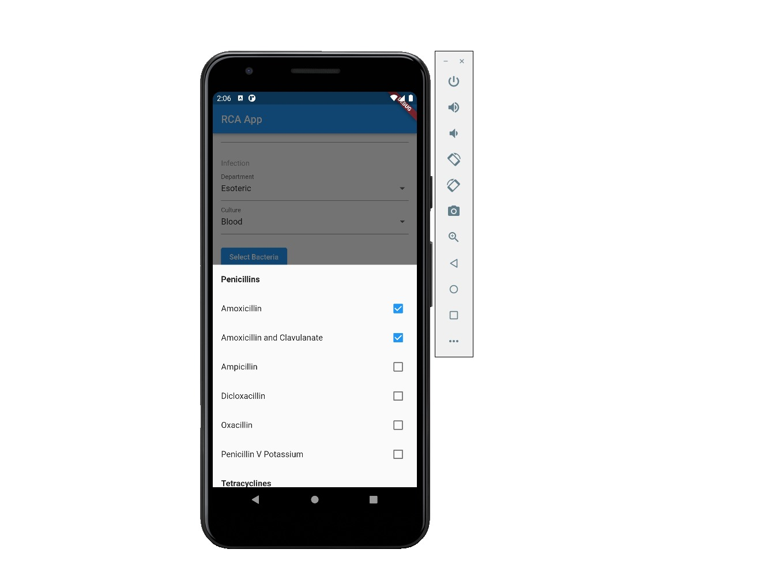
Other Picture From Mobile Application

Slide 37
Conclusion
Admin can create many users with different permissions.
Users can Fill & Update patient’s forms.
Admin or Authorized users can monitor consumption statistics.
Admin or Authorized users can send system announcements.
Admin can track users activities.
Admin can insert/update system data ( Departments, Bacteria Types, Antibiotic Types ).

Slide 38
Future Work
future of rationalizing the consumption of antibiotics will likely involve a combination of technological advancements, increased public education, regulatory oversight, and collaborative efforts among stakeholders. By working together to address the problem of antibiotic resistance, we can help ensure that antibiotics remain effective in treating serious infections and protecting public health for generations to come.
Increased global collaboration.
Improved diagnostic tools.
Development of new antibiotics.
Develop IOS version from our project.
Machine learning is booming in these days, there is an intent to use it for improving System to be more efficient and effective.

Slide 39
Any Question ?

Slide 40
Thank You

